Slide 1

Deep Dive into AI Agents using Semantic Kernel
Janarthanan Selvaraj

Slide 2
Agenda
Semantic Kernel – in a nutshell
AI Agents
AI Agents Capabilities
Why Semantic Kernel?
Semantic Kernel Architecture
AI Agents Components
Building your First Agents – Hands-on
Built-in Plugins – Hands-on
Creating Prompt Templates – Hands-on
Use Personas in Prompts – Hands-on

Slide 3
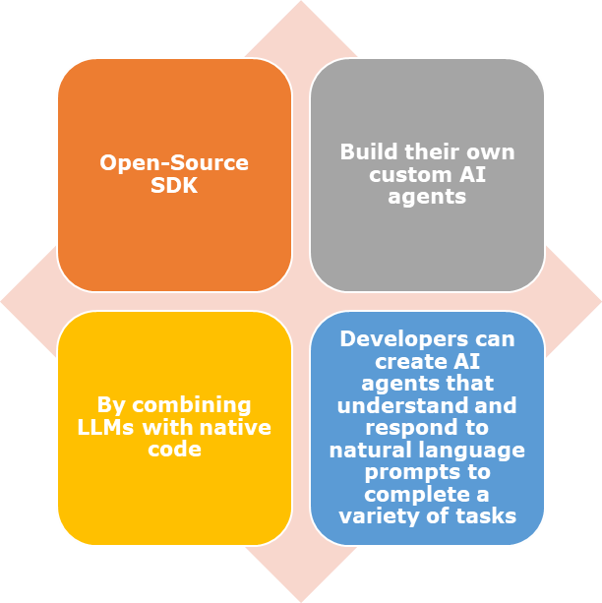
What is Semantic Kernel?

Slide 4
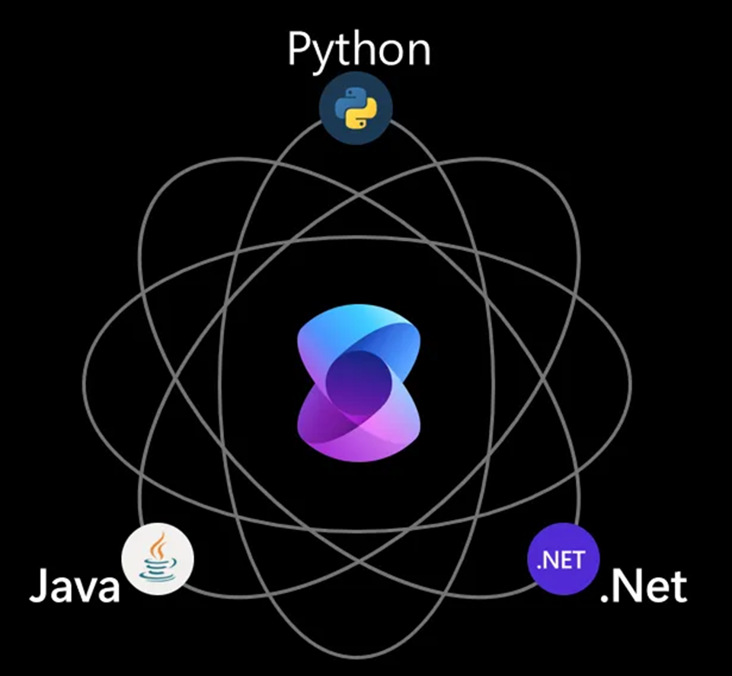
Supported Semantic Kernel Languages

Slide 5

Supported AI Endpoints

Slide 6

What’s an AI Agents?

Slide 7




AI Agents Capabilities
Write code
Compose emails
Summarize meetings
Provide recommendations

Slide 8
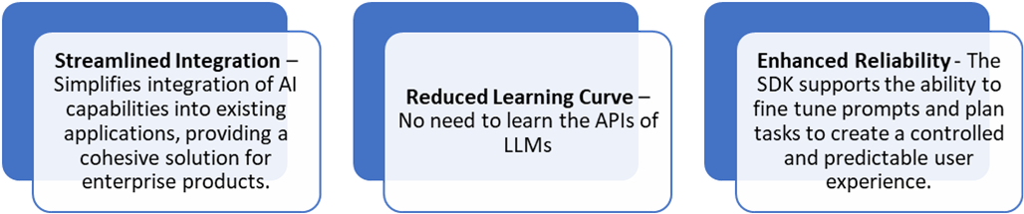
Why Semantic Kernel?

Slide 9
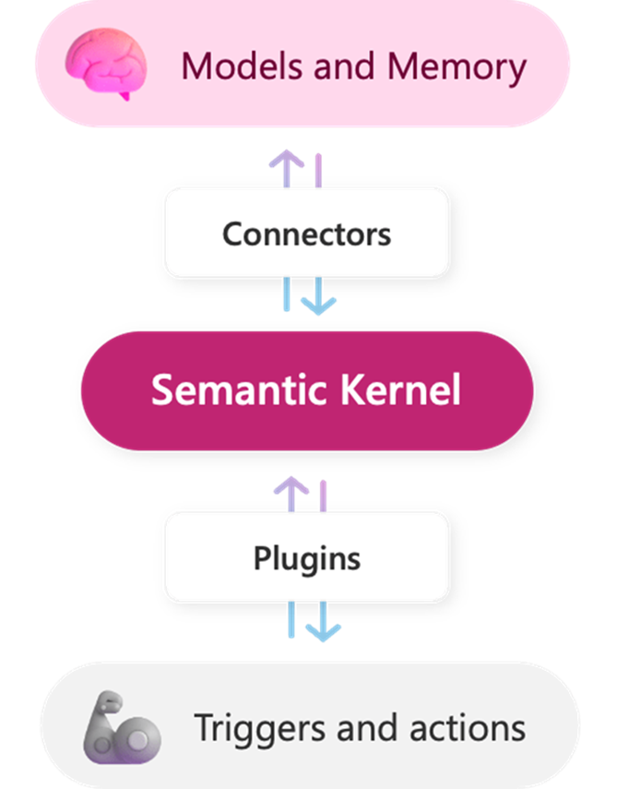
Semantic Kernel Architecture

Slide 10

Agents Components
Retrieve the information – Plugins
Plan how to use that information – Planners
Respond back to user or perform an action - Personas

Slide 11
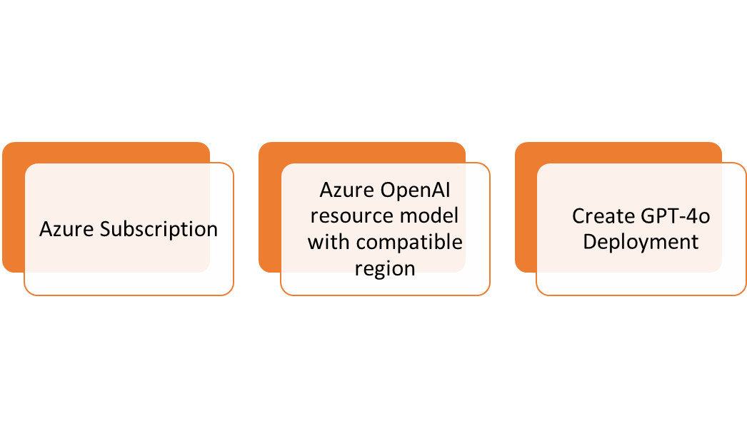
Prerequisites

Slide 12
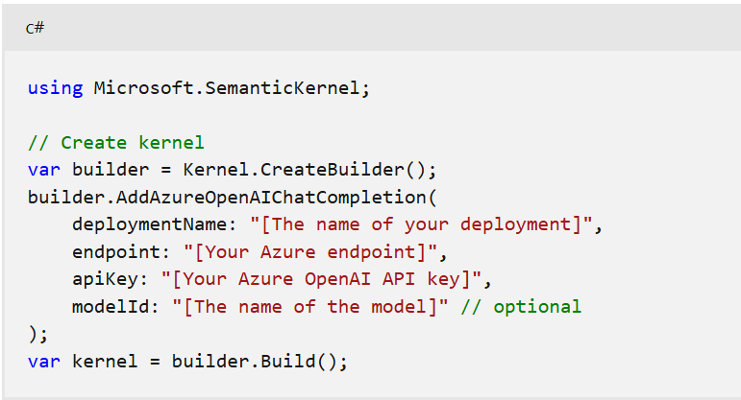
How to build your Kernel?

Slide 13
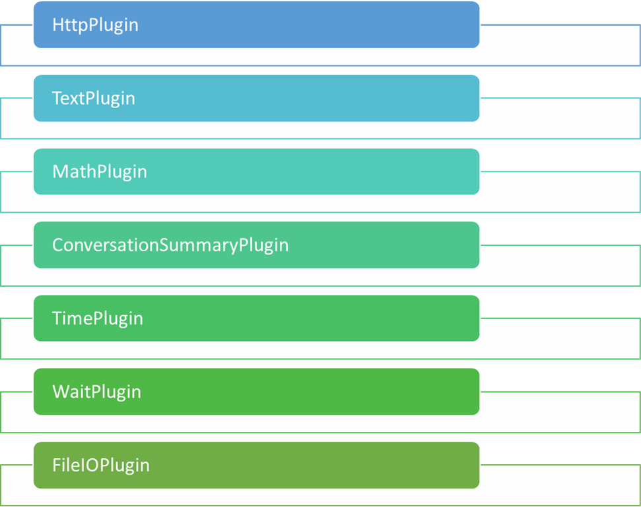
Built-in Plugins

Slide 14
Create Prompt Templates
The Semantic Kernel SDK supports a templating language that allows you to use expressions and variables in your natural language prompts.
To embed expressions in your prompts, the templating language uses curly brackets {{...}}.

Slide 15
Use Personas in Prompts
Assigning personas to your prompts can improve the quality of the responses generated by the large language model (LLM).
Personas provide context to the LLM, allowing it to consistently generate responses that are better aligned with your user's intent

Slide 16
Hands-on
Let's see the hands-on Demo

